Slide 1
Performing Report Delivery

Slide 2
Report Parts
Report parts work similar to shared datasets. The difference is a report part includes a report layout component in addition to the dataset. Report parts are created by taking the individual layout components and parameters of an existing report and saving them to the report server.
These bits of report definition can then be incorporated into other reports. Report parts can be saved to the server from SSDT, Visual Studio, and Report Builder.
However, only Report Builder can make use of report parts in the reports it creates. This is one of the few places where SSDT, Visual Studio, and Report Builder do not have the same capabilities.

Slide 3
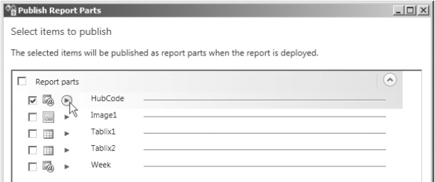
Saving Report Parts on the Report Server
Saving report parts to the report server is as easy as saving existing datasets as shared datasets. Let’s give it a try.
In SSDT or Visual Studio, open the Chapter08 solution, if it is not already open.
Close any open reports, and then open the Overtime Report.
In the Report menu, select Publish Report Parts. The Publish Report Parts dialog box appears. This dialog box lists the layout items and parameters in the Overtime Report.
Check the box for Hubcode.
Click the arrow next to HubCode as shown in figure below.

Slide 4
Saving Report Parts on the Report Server
Saving report parts to the report server is as easy as saving existing datasets as shared datasets. Let’s give it a try.
In the “Write a detailed description of the report part to help identify it” area, type The HubCode report parameter showing hubs with employees over 45 hours for the selected week.
Check the box for Tablix1.
Click Tablix1, and replace this text with Employees 45–55 Hours Worked.
Click the arrow next to this item, and type the following in the detailed description area: A tablix showing employees for a selected week at a selected hub with 45–55 hours worked.
Check the box for Tablix2.
Click Tablix2, and replace this text with Employees Over 55 Hours Worked.
Click the arrow next to this item, and type the following in the detailed description area: A tablix showing employees for a selected week at a selected hub with over 55 hours worked.
Check the box for Week.

Slide 5
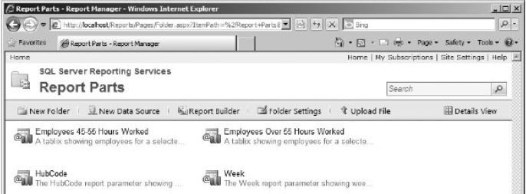
Saving Report Parts on the Report Server
Saving report parts to the report server is as easy as saving existing datasets as shared datasets. Let’s give it a try.
Click the arrow next to Week, and type the following in the detailed description area: The Week report parameter showing weeks for which employee time has been entered.
Click OK to publish the report parts.
Right-click the entry for the Overtime Report in the Solution Explorer, and select Deploy from the context menu. The report and the report parts will be deployed to the report server.
In Report Manager, navigate to the Report Parts folder. You should see the four report parts in the folder as shown in figure below.

Slide 6
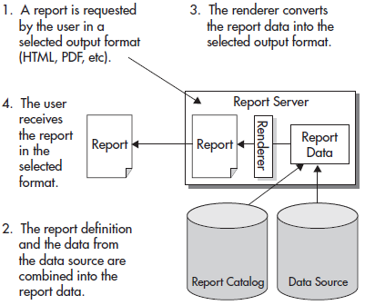
Caching In
One of the best features of Reporting Services is that the data is requeried each time the report is executed. This is shown in figure below.
The user is not viewing information from a static web page that is weeks or months old. Reporting Services reports include data that is accurate up to the second the report was run.
However, this feature can also be the source of one of the drawbacks of Reporting Services. The user is required to wait for the data to be requeried each time a report is run. If your query or stored procedure runs quickly, this may not be a problem.

Slide 7
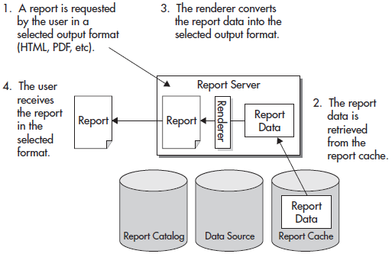
Report Caching
On subsequent executions, with the same parameter values chosen, the report server pulls the information necessary to render the report from the report cache, rather than requerying data from the database, as shown in figure below.
Because these subsequent executions do not need to requery data, they are, in most cases, faster than the report execution without caching.

Slide 8
Cached Report Expiration
Once an instance of the report is stored in the report cache, it is assigned an expiration date and time. The expiration date and time can be calculated in one of two ways.
The expiration date can be calculated based on a certain number of minutes after the creation of the cached instance. For example, the cached instance of the report exists for 30 minutes, and then it is deleted.
Or, the expiration date can be determined by a set schedule. For example, the cached instance of the report is deleted at 2:00 A.M. every Sunday morning.
The first type of expiration calculation is appropriate for a report that requires a large amount of database resources and is run often, but does not require up-to-the-second data.
The second type of expiration calculation is appropriate for reports run against data that changes on a scheduled basis.
Perhaps you have a report being run from your data warehouse. The data warehouse is updated from your transactional database each Sunday at 12:30 A.M.
The data in the warehouse remains static in between these loads.

Slide 9
Cached Reports and Data Source Credentials
To create a cached instance of a report, the report must be using stored credentials.
These can be credentials for either a Windows logon or a database logon, but they must be stored with the data source. If you think about this from a security standpoint, this is how it has to be.
Suppose for a minute that Reporting Services allowed a cached report to be created with Windows integrated security.
The Windows credentials of the first person to run the report would be used to create a cached instance of the report. Subsequent users who request this report would receive this cached instance.
However, this would mean the subsequent users are receiving data in the report created using the credentials from another user.
The only way that caching works without creating the potential for a security problem is with credentials stored with the report. In this situation, the same credentials are used to access the database - whether it is the VP or a lowly sales representative running the report.
There is no risk that the cached instance of the report will create a breach in database security.

Slide 10
Enabling Report Caching for the Weather Report
Let’s try enabling caching for the Weather report.
Open the Report Manager, and navigate to the Chapter 09 folder.
Hover over the WeatherReport, and select Manage from the drop-down menu. The Properties page for the WeatherReport appears.
Select Processing Options from the left side of the screen.
Select the “Cache a temporary copy of the report. Expire copy of report after a number of minutes” option.
Set the number of minutes to 45.
Click Apply.
Click the large WeatherReport title at the top of the page to run the report. Select (Select All) in the Select Planets drop-down list, and click View Report. The WeatherReport runs.

Slide 11
Viewing the Report from the Report Cache
Now let’s run the report again. Because a cached copy of the report has not expired, the report is rendered from the cached copy.
Click the Refresh Report button in the toolbar. The report appears almost immediately. That happened so fast, I bet you don’t even believe it retrieved the report. Let’s try it again another way.
Click the Chapter 09 link at the top of the page.
Click the WeatherReport link to run this report. Note, the Report Manager switched back to the non-detail, list view.
Select (Select All) in the Select Planets drop-down list, and click View Report.

Slide 12
Cache Expiration on a Schedule
You have just learned the weather web service we are using for our Weather report is updated every hour, on the hour. It makes sense for us to set our cached copy of this report to expire on this same schedule.
The cached copy should expire at five minutes past the hour so a new copy of the weather information shows up the next time the report is run after the web service information is updated.
Navigate to the Weather report in the Report Manager, if you are not already there.
Hover over the WeatherReport, and select Manage from the drop-down menu. The Properties page appears.
Select Processing Options from the left side of the screen. The Processing Options page appears.
Select Cache a temporary copy of the report. Expire copy of report on the following schedule.
Report-Specific Schedule is selected by default. Click Configure next to Report-Specific Schedule. The Schedule page appears.

Slide 13
Cache Expiration on a Schedule
You can specify hourly, 6. daily, weekly, monthly, or one-time schedules. Select Hour.
Leave the Hourly Schedule set to run every 1 hours 00 minutes. Set Start Time to five minutes after the next hour. (If it is 2:30 p.m. now, set Start Time to 3:05 p.m.)
Today’s date should be selected for Begin running this schedule on. Leave the Stop this schedule on blank. (You change these dates by clicking the calendar icon to the right of the entry area. You cannot type in the date directly.)
Click OK to return to the Processing Options page. Note the description of the schedule you just created under Report-specific schedule.
Click Apply to save your changes to the report cache settings.
Click the large WeatherReport title at the top of the page to run the report.
Check (Select All) in the Select Planets drop-down list, and click View Report.
The Weather Report runs.

Slide 14
Report Caching and Report Parameters
What happens with our report caching if different users enter different parameters when the report is executed?
Suppose one user runs the Weather report and only selects Borlaron from the Select Planets drop-down list.
The Weather report is cached with only the Borlaron information. Now a second user runs the report, selecting only Stilation.
Because a nonexpired instance of this report is in the report cache, it seems the report should come from the report cache.
If this were to happen, though, the second user would receive the Borlaron data instead of the Stilation data.
Fortunately, the report server is smart enough to handle this situation.
As part of the instance of the report in the report cache, the report server stores any parameter values used to create that cached instance, as shown in figure next page.
The cached instance is used to satisfy requests made by a subsequent user only if all the parameters used to create the cached instance match the parameters entered by the subsequent user.

Slide 15
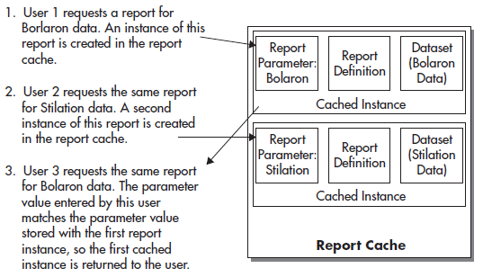
Report Caching and Report Parameters

Slide 16
Report Snapshots
Report caching is a great tool for improving the performance of reports with long execution times, but one problem still exists. The first user who requests the report after the cached instance has expired must wait for the report to be created from the underlying data.
It would be nice if there were a way to have cached report instances created automatically so no user has to endure these wait times. Fortunately, Reporting Services can do this as well.
An report snapshot is another way to create a cached report instance. Up to this point, we have discussed situations where cached report instances are created as the result of a user action.
A user requests a report, and a copy of that report’s intermediate format is placed in the report cache. With execution snapshots, a cached report instance is created automatically.
Report snapshots can create cached report instances on a scheduled basis, or they can be created as soon as this feature is turned on for a particular report.
If a schedule is used, each time the schedule is run, it replaces the current cached instance with a new one.
Cached report instances created by an execution snapshot are used to satisfy user report requests the same as any other cached report instance.

Slide 17
Manually Creating an Report Snapshot
Let’s try enabling report snapshots for the Weather report.
Navigate to the Weather report in the Report Manager, if you are not already there.
Hover over the WeatherReport, and select Manage from the drop-down menu. The Properties page appears.
Select Processing Options from the left side of the screen. The Processing Options page appears.
Select the Render this report from a report snapshot option.
Make sure the “Check the Create a report snapshot when you click the Apply button on this page” check box is checked.
Click Apply. Note the error message that appears next to the report snapshot option. When a report snapshot is created, it is done as a background process, so no one will be available to select a value for the report parameter. Because this parameter has no default value, the report server does not know what value to use for the report parameter when the report is run by the schedule. Let’s provide a default value for the parameter so we can proceed.
Select Parameters from the left side of the screen. The Parameters page appears.
Check the check box in the Has Default column.

Slide 18
Manually Creating an Execution Snapshot
Enter the following in the Default Value drop-down edit area:
AFU
BLN
NOX
RKM
SLN
SRA
Click Apply to save the default value.
Let’s try to set up snapshot execution again. Select Execution from the left side of the screen. The Execution Properties page appears.
Select the Render this report from a report snapshot option.
Check the Create a report snapshot when you click the Apply button on this page check box.
Click Apply. As soon as you click Apply, the report server executes the report and places an instance of the report in the report cache. Allow time for this process to complete.
Click the large WeatherReport title at the top of the page to run the report.

Slide 19
Creating Report Snapshots on a Schedule
Now let’s try the scheduled approach to creating execution snapshots.
Click the WeatherReport link at the top of the page. The Processing Options page should appear. If not, select Processing Options from the left side of the page.
Check the Use the following schedule to create report snapshots check box.
Report-specific schedule is selected by default. Click Configure next to Reportspecific schedule. The Schedule page appears.
You can specify hourly, daily, weekly, monthly, or one-time schedules. The Day option should be selected by default. Leave this option selected.
Select the On the following days option, if it is not already selected.
Uncheck all the days except for today. (If you are reading this on Monday, for example, leave only Monday checked.)
Set the start time to five minutes from now.
Select today’s date for Begin running this schedule on.
Check the Stop this schedule on check box, and then select tomorrow’s date.

Slide 20
Creating Execution Snapshots on a Schedule
Click OK to return to the Processing Options page. Note the description of the schedule you just created under Report-specific schedule.
Click Apply to save your changes to the report snapshot settings. After five minutes, the scheduled report snapshot will create a cached instance of the report.
Click the large WeatherReport title at the top of the page to execute the report. The Weather Report runs and is rendered from the cached report instance created by your scheduled report snapshot.

Slide 21
Report History
The report history feature of the Report Manager enables you to keep copies of a report’s past execution.
This lets you save the state of your data without having to save copies of the data itself.
You can keep documentation of inventory levels, production schedules, or financial records.
You can look back in time, using the report history, to do trend analysis or to verify past information.

Slide 22
Enabling Report History
To demonstrate the report history feature of Reporting Services, we need a report whose results change often. It just so happens we have such a report in our Chapter08 solution.
The TransportMonitor report provides different values every time the report is run. We can move that report to the report server and then enable the report history.
If you composed your reports with SSDT or Visual Studio, upload the TransportMonitor report from the Chapter09 project.
Navigate to the Chapter09 folder, hover over the TransportMonitor report, and select Manage from the drop-down menu. The Properties page appears.
Click Parameters on the left side of the page.
Select the Has Default check box, and type 1304 for Default Value.
Click Apply.
Click Snapshot Options on the left side of the page. The Snapshot Options page appears.
Make sure the Allow report history to be created manually check box is checked. If it is not, check it and click Apply.

Slide 23
Enabling Report History
Click the large TransportMonitor title at the top of the page to execute the report. Remember, this report has autorefresh set. After about a minute, the report refreshes and new data is displayed.

Slide 24
Manually Creating a Report History Snapshot
One way to create a report history is to do so manually. We can give this a try in the following example.
Click the TransportMonitor link at the top of the page.
Click Report History on the left side of the page.
Click the New Snapshot button in the report viewer toolbar. An entry for a report history snapshot appears.
Click the New Snapshot button two more times to create two more report history snapshots.
Click the link in the Last Run column to the first report history snapshot you created. This report should appear in a new browser window.
Open the other two report history snapshots, and compare all three.
As with the cached report instances, the report history snapshots store the intermediate format of the report. Because of this, you can export this report to any of the rendering formats.

Slide 25
Report History Snapshots and Report Parameters
To make our TransportMonitor report work with report history snapshots, we had to provide a default value for the transport number parameter. These parameters cannot be changed when each snapshot is created.
Essentially, we are saving report history snapshots for only one transport. To save report history snapshots for other transports, we need to create linked reports with parameters defaulted to the other transport numbers.
Click the Properties tab.
Click Create Linked Report.
Type Transport 1305 Monitor for Name and The Transport Monitor Report for Transport 1305 for Description.
Click OK. The linked report executes.
Click the Transport 1305 Monitor link at the top of the page. This takes us to the Properties page for the report.
Click Parameters on the left side of the page.
Change Default Value to 1305.
Click Apply.
Click Report History on the left side of the page.
Click New Snapshot.
Click the entry for the new snapshot to view it. You can see this is a snapshot for transport number 1305.
Close the browser window containing your report history snapshot.

Slide 26
Setting Limits on the Number of Report History Snapshots
Reporting Services provides a way to limit the number of history snapshots saved for any given report. Let’s take a look and put a limit on our TransportMonitor report snapshots at the same time.
Click Snapshot Options on the left side of the page.
In the Select the number of snapshots to keep section of the page, select the Limit the copies of report history option.
Set the limit to 5.
Click Apply to save your changes to the history snapshot settings.
Click OK in response to the warning dialog box.
Click Report History.

Slide 27
Updating Report Definitions and Report History Snapshots
One of the best features of report history snapshots is this: They are not lost if the definition of the underlying report is changed. Let’s see this in action.
Open the TransportMonitor report in your report authoring environment of choice.
In the Report Data window, right-click the entry for the TransportMonitor dataset, and select Dataset Properties from the context menu. The Dataset Properties dialog box appears.
Select the Filters page.
Click the Add button to add a filter.
Select [Item] from the Expression drop-down list. Select <> from the Operator drop-down list. Enter Thruster for the Value. This filter removes the thruster data from the report.
Click OK to exit the Dataset Properties dialog box.
Preview/Run the report. Check 1304 in the Transports drop-down list, and click View Report. Note the Thruster graph is missing.
Save the report.
If you are using SSDT or Visual Studio, deploy the report.
Close your development environment.

Slide 28
Updating Report Definitions and Report History Snapshots
Close your development environment.
Return to the Report Manager in your browser.
If you are using Report Builder, you need to reset the parameter default. Go to the Parameters page to select the Has Default check box, type 1304 for Default Value, and click Apply.
Click the large TransportMonitor title to run the report. Note the report now includes our change, eliminating the thruster data from the report.
Click the TransportMonitor link at the top of the page. This should return you to the Report History page. We still have some report history snapshots based on the old report definition.
Click New Snapshot to manually create a report history snapshot based on the new report definition. Our five-history-snapshot limit is still in effect, so one of the old history snapshots may have to be deleted to make room for the new one.
Click the most recent history snapshot to view it. It does not contain thruster data because it is based on the new report definition.
Close this browser window.
Click the oldest history snapshot to view it. It does contain thruster data because it is based on the old report definition.
Close this browser window.

Slide 29
Subscriptions
Up to this point, we have discussed only one way for users to receive reports.
They log on to the Report Manager site, find the report they want, and execute it, which is known as pull technology.
The user pulls the information out of Reporting Services by initiating the execution of the report.
Reporting Services also supports push technology for delivering reports.
In a push technology scenario, Reporting Services initiates the execution of the report and then sends the report to the user.
This is done through the report subscription.

Slide 30
Creating a Standard E-mail Subscription with an Embedded Report
You have been hired as the traffic manager for Galactic Delivery Services and are responsible for routing transport traffic. As part of your job, it is important to know what the weather is like at all the hubs.
Rather than taking the time to go look at the Weather report on the Report Manager website, you want to have the report e-mailed to you hourly.
Open the Report Manager, and navigate to the Chapter09 folder.
Hover over the WeatherReport, and select Manage from the drop-down menu.
Click Subscriptions on the left side of the page.
Click New Subscription. The Subscription Properties page appears.
The Delivered by drop-down list defaults to E-Mail. Leave this set to the default setting.
Type your e-mail address for To. Note that you can enter multiple e-mail addresses, separated by a semicolon (;), and you can also enter e-mail addresses for Cc and Bcc.
Enter an e-mail address for Reply-To. This can be your own e-mail address, someone else’s, or a dummy e-mail address that does not exist.

Slide 31
Creating a Standard E-mail Subscription with an Embedded Report
By default, the subject of the e-mail is the name of the report, followed by the time the report was executed. Change Subject to @ReportName.
Leave the Include Report check box checked. This includes the report in the e-mail. Uncheck the Include Link check box.
The Render Format drop-down list defaults to MHTML (web archive). Leave this selected.
Select High from the Priority drop-down list.
For Comment, type This e-mail was sent from Reporting Services.
Under the Run the subscription heading, select the When the scheduled report run is complete option.
Click Select Schedule. The Schedule page appears.
Select Hour.
Leave the schedule to run every 1 hour and 00 minutes. Set the start time to five minutes from now.
Today’s date should be selected for Begin running this schedule on.
Check Stop this schedule on, and select tomorrow’s date.

Slide 32
Creating a Standard E-mail Subscription with an Embedded Report
Click OK to return to the Subscription Properties page.
Note the default parameter values for this report appear in the Report Parameter Values section of this report. If necessary, you can specify parameters to use when running this subscription. Leave the parameter set to its default.
Click OK to create this standard subscription and return to the View/Edit Subscriptions page.
After the time specified by your schedule has passed, refresh this page. You should see the time of the execution in the Last Run column and Mail Sent To, followed by your e-mail address, in the Status column. You should also have a high-priority e-mail waiting for you in your mailbox.
Do not delete this subscription until you have had a chance to look at the My Subscriptions page in the section “My Subscriptions.”

Slide 33
Creating a Standard E-mail Subscription with a Report Link
You have just been promoted to sales manager for the Axelburg office of Galactic Delivery Services. Congratulations! Being a good manager, you want to keep tabs on how your salespeople are doing. To do this, you want to view the Invoice-Batch Number Report each week to see how much you are invoicing your clients. As a memory aid, you want to receive an e-mail each week with a link to this report.
Open the Report Manager, and navigate to the Axelburg folder.
Hover over the Invoice-Batch Number Report, and select Subscribe from the drop-down menu. The Subscription Properties page appears.
The Delivered by setting defaults to E-Mail. Leave this as the default setting.
Type your e-mail address for To.
Enter an e-mail address for Reply-To.
Change Subject to @ReportName.
Uncheck the Include Report check box. Leave the Include Link check box checked.

Slide 34
Creating a Standard E-mail Subscription with a Report Link
Render Format is not used because we are just embedding a link to the report.
Select High from the Priority drop-down list.
For Comment, type Remember to check the invoice amounts.
Under the Run the subscription heading, select the When the scheduled report run is complete option.
Click Select Schedule. The Schedule page appears.
Select Week.
Leave Repeat after this number of weeks set to 1.
Check today for On day(s). For example, check Mon if today is Monday. Uncheck all the other days.
Set the start time to five minutes from now.
Today’s date should be selected for Begin running this schedule on.
Check Stop this schedule on, and select tomorrow’s date.
Click OK to return to the Subscription Properties page.
At the bottom of the Schedule Properties page, you see a list of the parameters for the selected report. Leave the default values for the parameters.
Click OK to create this standard subscription and return to the Report Viewer page.

Slide 35
Standard Subscriptions and Execution Snapshots
In addition to creating your own schedule for your standard subscriptions, you can synchronize your subscriptions with scheduled execution snapshots.
For example, the Weather report is set to create an execution snapshot every hour.
We want to receive an e-mail with the new version of the report after each new execution snapshot has been created.
One way to do this is to keep the schedule for the execution snapshot synchronized with the schedule for the subscription. The execution snapshot runs, and then the subscription runs one minute later.
This can cause problems if the execution snapshot occasionally takes more than one minute to create or if one of the schedules is edited.
A better solution is to let the creation of the execution snapshot drive the delivery of the subscription. The When the Report Content Is Refreshed option does just that.
When this option is selected for a subscription, the subscription is sent out every time a new execution snapshot is created.
Of course, this option is only available for reports that have execution snapshots enabled.

Slide 36
Multiple Subscriptions for One Report
Nothing prevents a user from creating more than one subscription for the same report.
Perhaps you want a report delivered every Friday and on the last day of the month.
You can’t do this with one subscription, but you can certainly do it with two - a weekly subscription for the Friday delivery and a monthly subscription for delivery on the last day of the month.
Another reason for multiple subscriptions is to receive a report run for multiple sets of parameters. You saw it is possible to specify parameter values as part of the subscription properties.
Using this feature, you could have one subscription send you a report with one set of parameters and another subscription send you the same report with a different set of parameters.

Slide 37
Embedded Report Versus Attached Report
When you choose to include the report along with the subscription e-mail, the report can show up either embedded in an HTML e-mail or as an attached document.
If you select the Web Archive format, the report is embedded. If you select any of the other render formats, the report is sent as an attached document.
Having the report embedded in the e-mail makes it convenient for the user to view the report: It is simply part of the body of your e-mail.
However, not all e-mail packages support HTML e-mail, so some users might be unable to view an embedded report.
If a user is unsure of the capabilities of their e-mail package, they should choose the Acrobat (PDF) file format.
This format is sent as an attachment and can be viewed by just about anyone.

Slide 38
Standard Subscriptions and Security
Not all users can create standard subscriptions. In fact, it is possible to view a report, but not be able to subscribe to it.
To subscribe to a report or create a subscription for delivery to others, you must have rights to the Manage Individual Subscriptions task.
Of the four predefined security roles, the Browser, Content Manager, and My Reports roles have rights to manage individual subscriptions.

Slide 39
Creating a Data-Driven Subscription
The data-driven subscription enables you to take a report and e-mail it to a number of people on a mailing list.
The mailing list can be queried from any valid Reporting Services data source.
Transport 1305 has been acting up. Galactic Delivery Services (GDS) wants all its
mechanics to have a good background on the types of problems this transport is having.
To facilitate this, the results from the Transport 1305 Monitor report should be e-mailed to all mechanics every four hours.
Employees holding the position of Mechanic I should receive the report as a high-priority e-mail.
Employees holding the position of Mechanic II should receive the report as a normal-priority e-mail.
Open the Report Manager, and navigate to the Chapter09 folder.
Hover over the Transport 1305 Monitor report, and select Manage from the drop-down menu.
Click Subscriptions on the left side of the page.
Click the New Data-driven Subscription button. The first page of the data-driven subscription process appears, as shown in next slide.

Slide 40
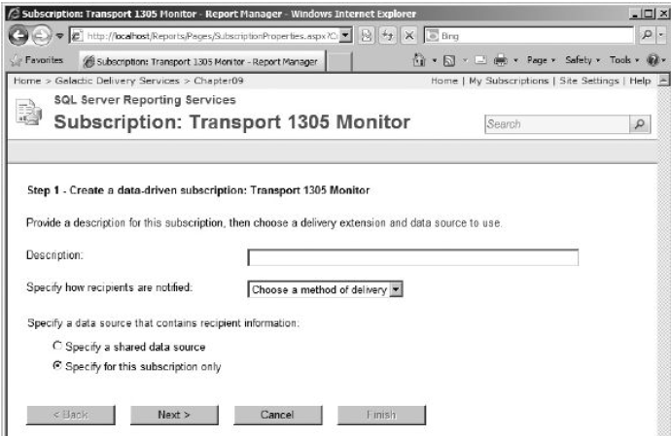
Creating a Data-Driven Subscription
Type Maintenance Watch on Transport 1305 for Description.
Select E-Mail from the Specify how recipients are notified drop-down list.
Select the Specify a shared data source option.
Click the Next button. The Shared Data Source page appears, as shown in next slide.

Slide 41
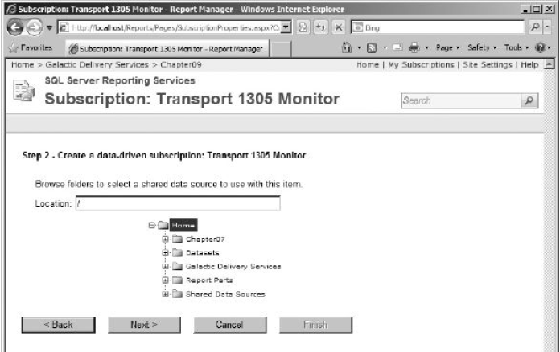
Creating a Data-Driven Subscription
Use the tree view to find and select the Galactic shared data source.
Click the Next button. The Query page appears, as shown in next slide.

Slide 42
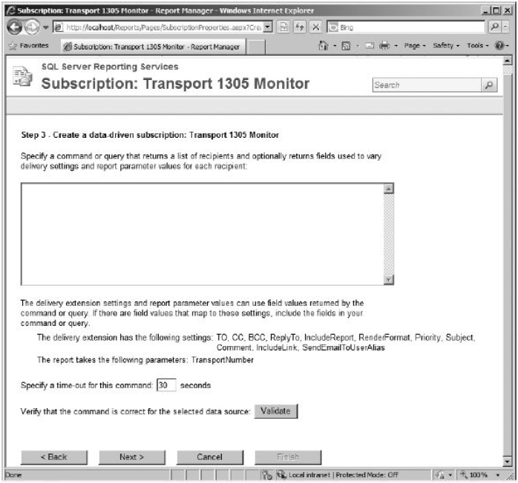
Creating a Data-Driven Subscription
Type the following for the
query:
EXEC stp_MechanicMailingList
Click Validate to make sure
you don’t have any typos or
other problems.
If the query does not validate
successfully, look for the error
in the query you typed.
Otherwise, click Next.
The Data Association page appears,
as shown in next slide. Here,
you can associate columns in
the result set with fields in the subscription e-mail.

Slide 43
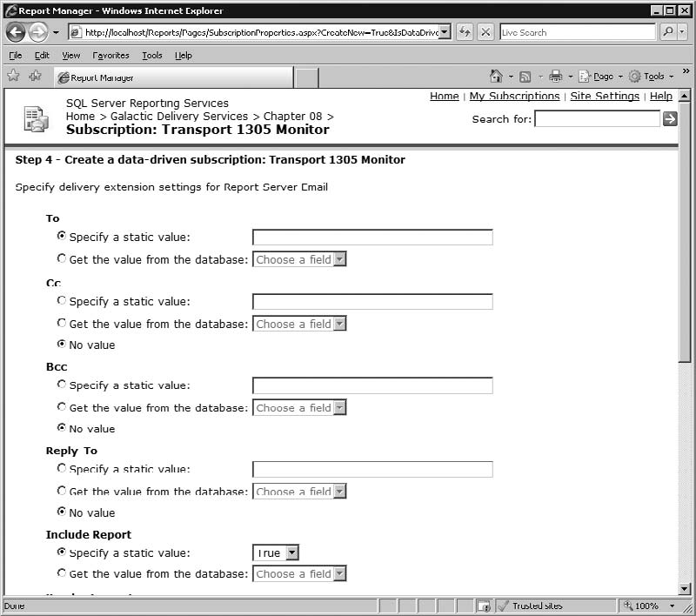
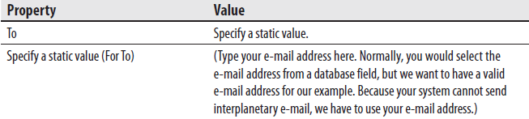
Creating a Data-Driven Subscription
Set the following properties on this page:

Slide 44
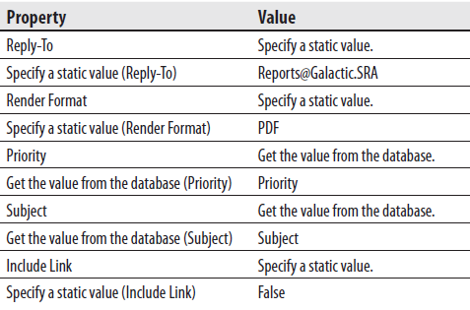
Creating a Data-Driven Subscription
Set the following properties on this page:
Click the Next button. The Parameter Values page appears.
Click the Next button. The Notify Recipients page appears.
Select the On a Schedule Created for This Subscription option.
Click the Next button. The Schedule page appears.
Select the Hour option.
Change the schedule to run every 4 hours 00 minutes.
Set the start time to five minutes from now.
Today’s date should be selected for Begin Running This Schedule On.

Slide 45
Creating a Data-Driven Subscription
Check Stop this schedule on, and select tomorrow’s date.
Click Finish.
Once the scheduled time for your subscription has passed, refresh this page. You should see the time of the execution in the Last Run column and Done: 8 processed of 8 total; 0 errors in the Status column.
You should also receive eight e-mails (eight mechanics are in the database, and we sent an e-mail to each one) with the Transport 1305 Monitor report attached.
If you do not want to receive eight e-mails every four hours for the next day, you can delete this subscription.

Slide 46
The General Site Settings Page
The main Site Settings page enables you to set several default values and configuration options. This page also acts as a front end for other configuration screens.
You can access the Site Settings page by clicking the Site Settings link at the top of the page.
The main Site Settings page is shown in figure below.

